Slide 1
DataLink Layer Functionalities
Lecture 9

Slide 2
Providing services to the network layer:
1 Unacknowledged connectionless service. Appropriate for low error rate and real-time traffic. Ex: Ethernet
2. Acknowledged connectionless service. Useful in unreliable channels, WiFi. Ack/Timer/Resend
3. Acknowledged connection-oriented service. Guarantee frames are received exactly once and in the right order. Appropriate over long, unreliable links such as a satellite channel or a longdistance telephone circui

Slide 3
Functionalities
Framing: Frames are the streams of bits received from the network layer into manageable data units. This division of stream of bits is done by Data Link Layer.
Physical Addressing: The Data Link layer adds a header to the frame in order to define physical address of the sender or receiver of the frame, if the frames are to be distributed to different systems on the network.

Slide 4
Functionalities
Flow Control:
A receiving node can receive the frames at a faster rate than it can process the frame. Without flow control, the receiver's buffer can overflow, and frames can get lost.
To overcome this problem, the data link layer uses the flow control to prevent the sending node on one side of the link from overwhelming the receiving node on another side of the link. This prevents traffic jam at the receiver side.

Slide 5
Functionalities
Error Control:
Error control is achieved by adding a trailer at the end of the frame. Duplication of frames are also prevented by using this mechanism. Data Link Layers adds mechanism to prevent duplication of frames
Error detection: Errors can be introduced by signal attenuation and noise. Data Link Layer protocol provides a mechanism to detect one or more errors. This is achieved by adding error detection bits in the frame and then receiving node can perform an error check.
Error correction: Error correction is similar to the Error detection, except that receiving node not only detects the errors but also determine where the errors have occurred in the frame.

Slide 6
Functionalities
Access Control: Protocols of this layer determine which of the devices has control over the link at any given time, when two or more devices are connected to the same link.
Reliable delivery: Data Link Layer provides a reliable delivery service, i.e., transmits the network layer datagram without any error. A reliable delivery service is accomplished with transmissions and acknowledgements. A data link layer mainly provides the reliable delivery service over the links as they have higher error rates and they can be corrected locally, link at which an error occurs rather than forcing to retransmit the data.

Slide 7
Functionalities
Half-Duplex & Full-Duplex:
In a Full-Duplex mode, both the nodes can transmit the data at the same time. In a Half-Duplex mode, only one node can transmit the data at the same time.

Slide 8
Framing
Framing in networking is like putting a letter in an envelope before sending it. It's a way to package chunks of data (called frames) so that they can be sent over a network.
Imagine you have a long message to send, but you can only send a limited amount of data at a time.
Framing helps break up this message into smaller, manageable pieces. Each piece (frame) gets a little "envelope" with information like where it's from, where it's going, and how big it is. This way, when it reaches its destination, the receiver knows how to put everything back together in the right order.
So, framing helps organize data for efficient and reliable transmission across a network.

Slide 9
Methods in Framing
There are total 4 methods in framing:
1. Character count.
2. Flag bytes with byte stuffing.
3. Starting and ending flags, with bit stuffing.
4. Physical layer coding violations.

Slide 10
Character Count
Character counting in framing is like placing a label on each part of a message.
Imagine you have a message and you want to send it over a network. Instead of breaking the message into fixed-size chunks, you count the characters in each chunk and write that count at the beginning.
This count acts like a label, telling the receiver how many characters to expect in that chunk.

Slide 11
Character Count
For example, if your message is "Hello!", character counting framing would send it like this: "6Hello!". The receiver sees the "6" and knows to expect six characters after it.
This way, the receiver can properly reconstruct the original message by reading the character count and extracting the correct number of characters from each chunk. It's a simple and effective way to organize data for transmission.

Slide 12
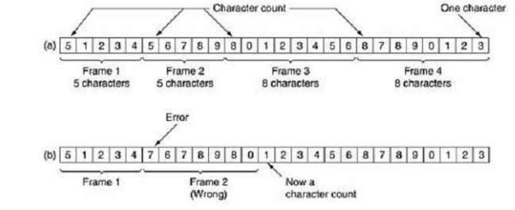
Character Count

Slide 13
Problems with Character counting
Handling Special Characters: If the data being sent includes control characters or special symbols (like newline characters, tabs, etc.), counting characters may become problematic. These characters can be misinterpreted, leading to incorrect frame sizes.
Error Handling: In case of errors during transmission, if a character is lost or corrupted, it can throw off the entire framing process. The receiver may misinterpret the character count, leading to data being improperly reconstructed.

Slide 14
Problems with Character Count
Variable-Length Characters: Different characters can have different byte lengths in certain character encodings. For example, in UTF-8 encoding, some characters can be represented by multiple bytes. This can cause issues in accurately counting characters.
Synchronization: Both the sender and receiver need to agree on the character encoding and how they count characters. If there's a mismatch, frames may be received incorrectly.
Efficiency: Character counting may not be the most efficient method, especially for encoding schemes that use variable-length characters. It may lead to inefficiencies in terms of bandwidth usage.

